Slide 1

Celestial Body Classification
&
Large Scale Structure
北京大学天文系 林小靖
linxiaojing@pku.edu.cn

Slide 2
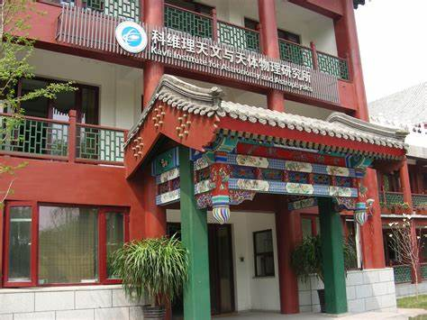
01
科学背景
Classification
Data Preparation
Algorithms
Results
02
目录
Outline
03
Clustering
Data Preparation
Algorithms
Results

Slide 3
科学背景
观测
Image
证认
分类
星表
Cross-match
Spectrum
信息提取
科研
Map
correlation

Slide 4
科学背景
Host galaxy
QSO
Spectrum
OBAFGKM…
Luminosity
012345…
Galaxy:
spiral
Elliptical
irregular…

Slide 5

科学背景
SDSS
Sloan Digital Sky Survey
斯隆数字化巡天
Database
SDSS – I , II , III
… , DR16
Skyserver SQL
新墨西哥州阿帕奇山顶天文台 2.5米口径望远镜 红移巡天
Target : 高红移类星体
https://data.sdss.org/sas/ $ 250,000

Slide 6
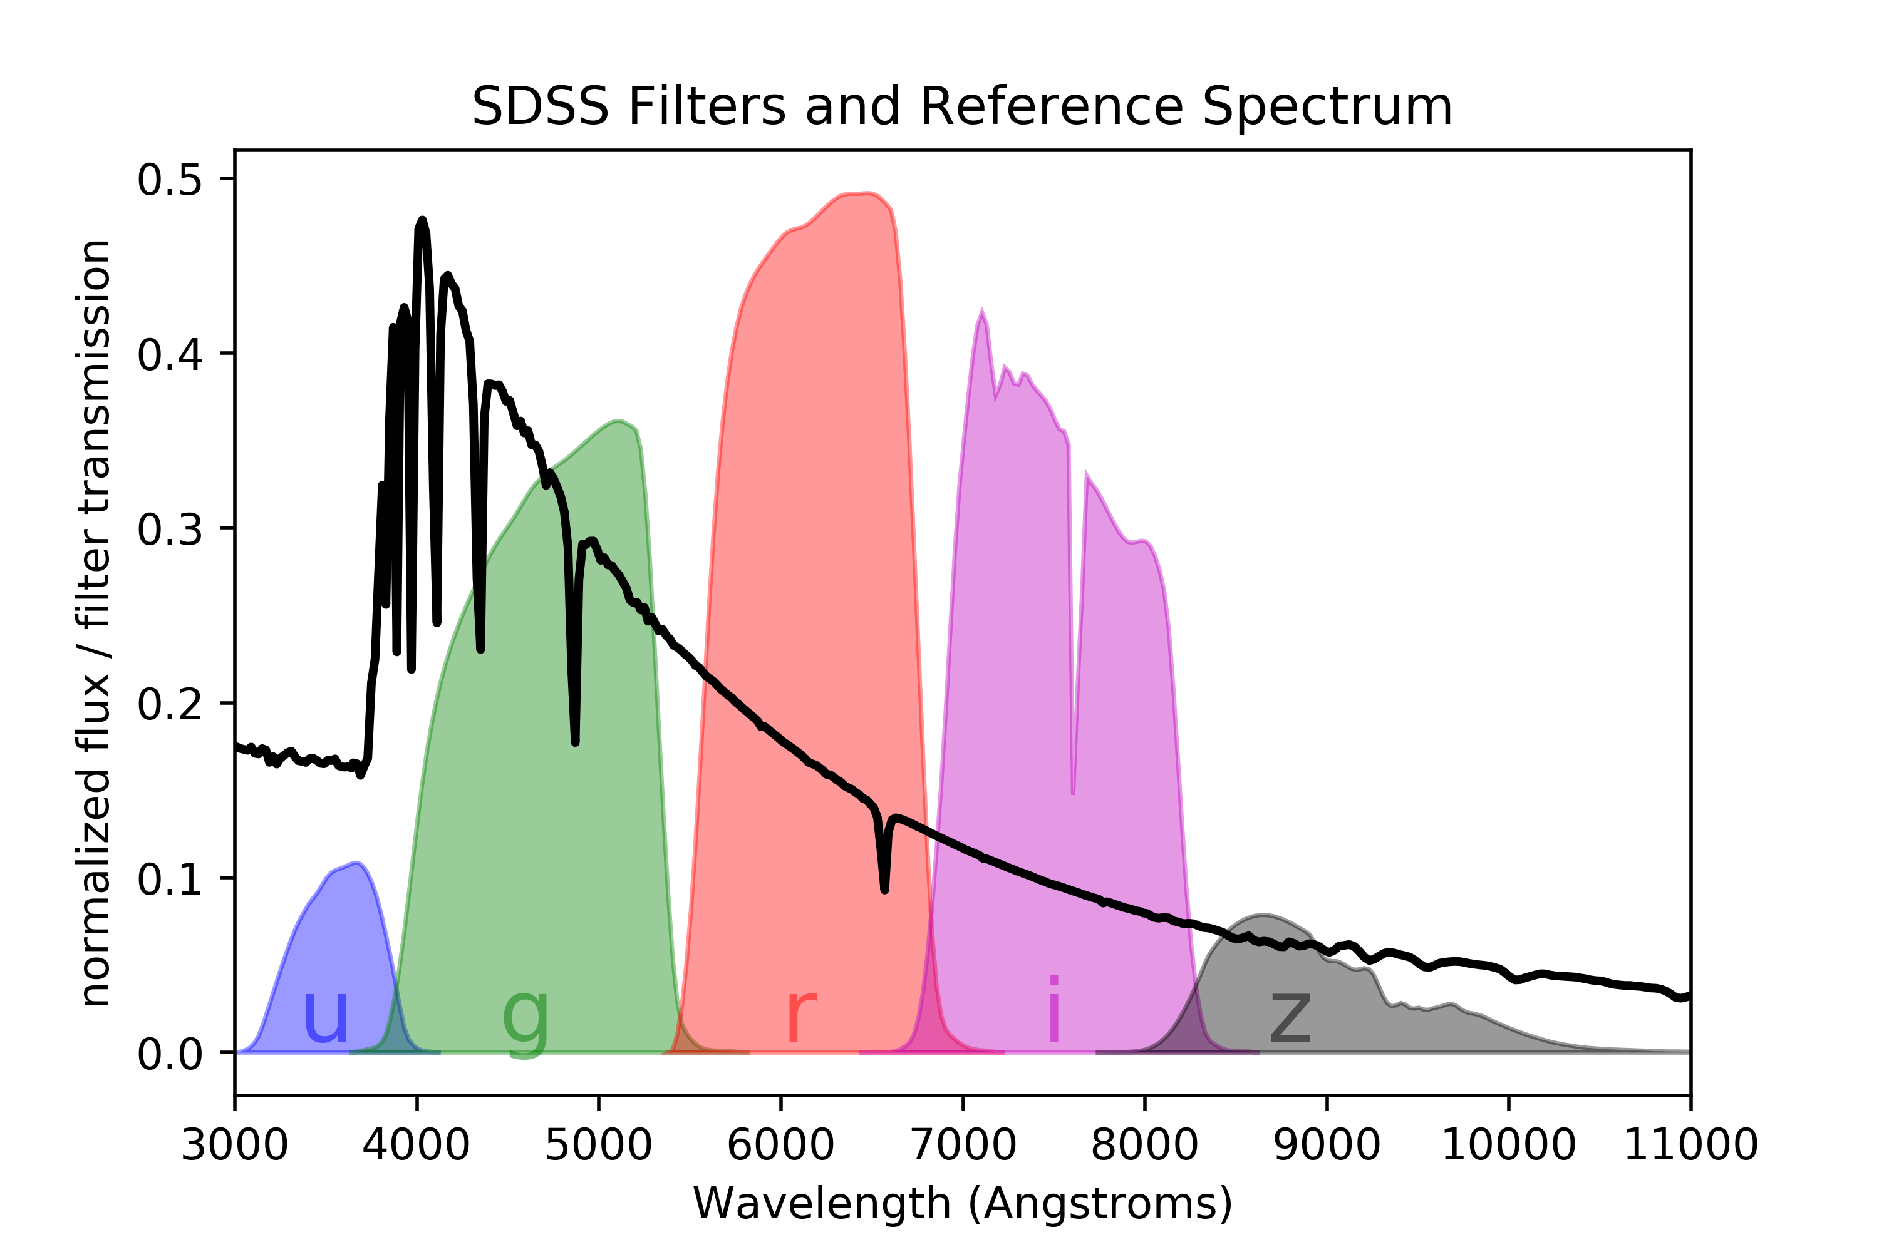
Classification
SDSS DR12 spssOutput.fits
1,843,200 objects
239 columns ( value & Error )
52 spectral classes
1.9 GB
8 features
Data
Teff | Log g | FeH | b-v , u-g , g-r , r-i , i-z
Effective temperature | gravity | Fe Abundance | Color index

Slide 7
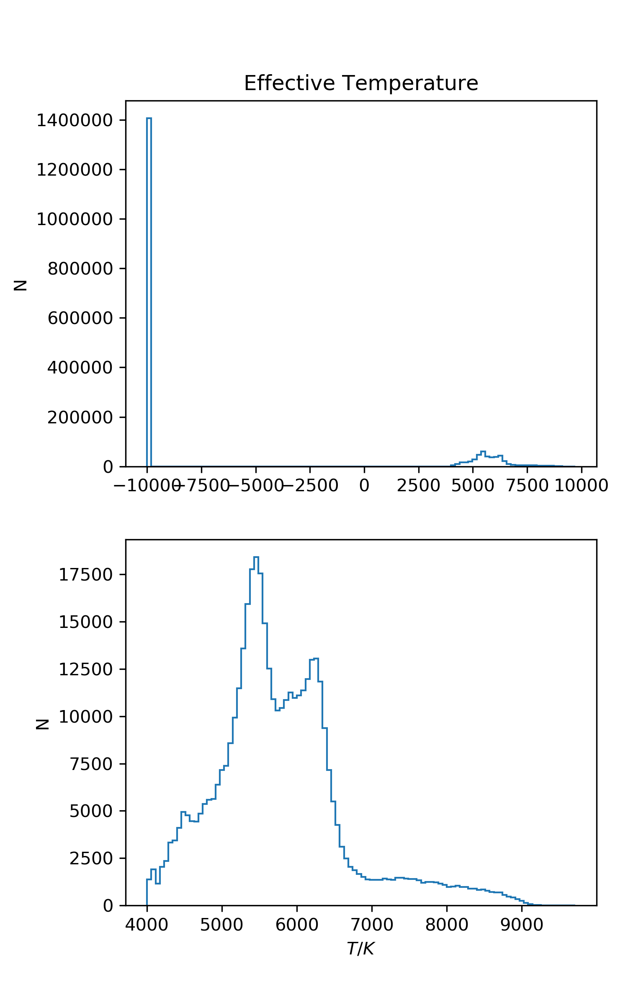
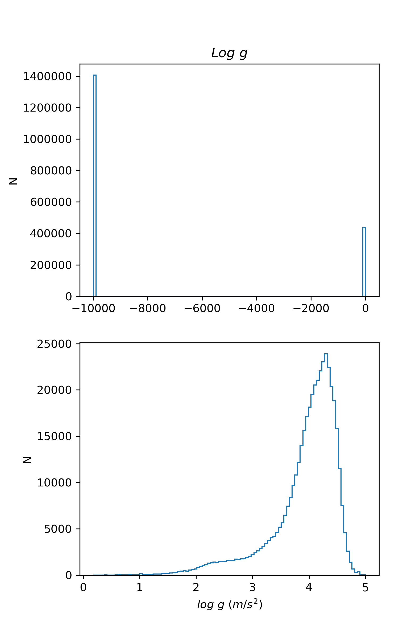
Data
Feature

Slide 8
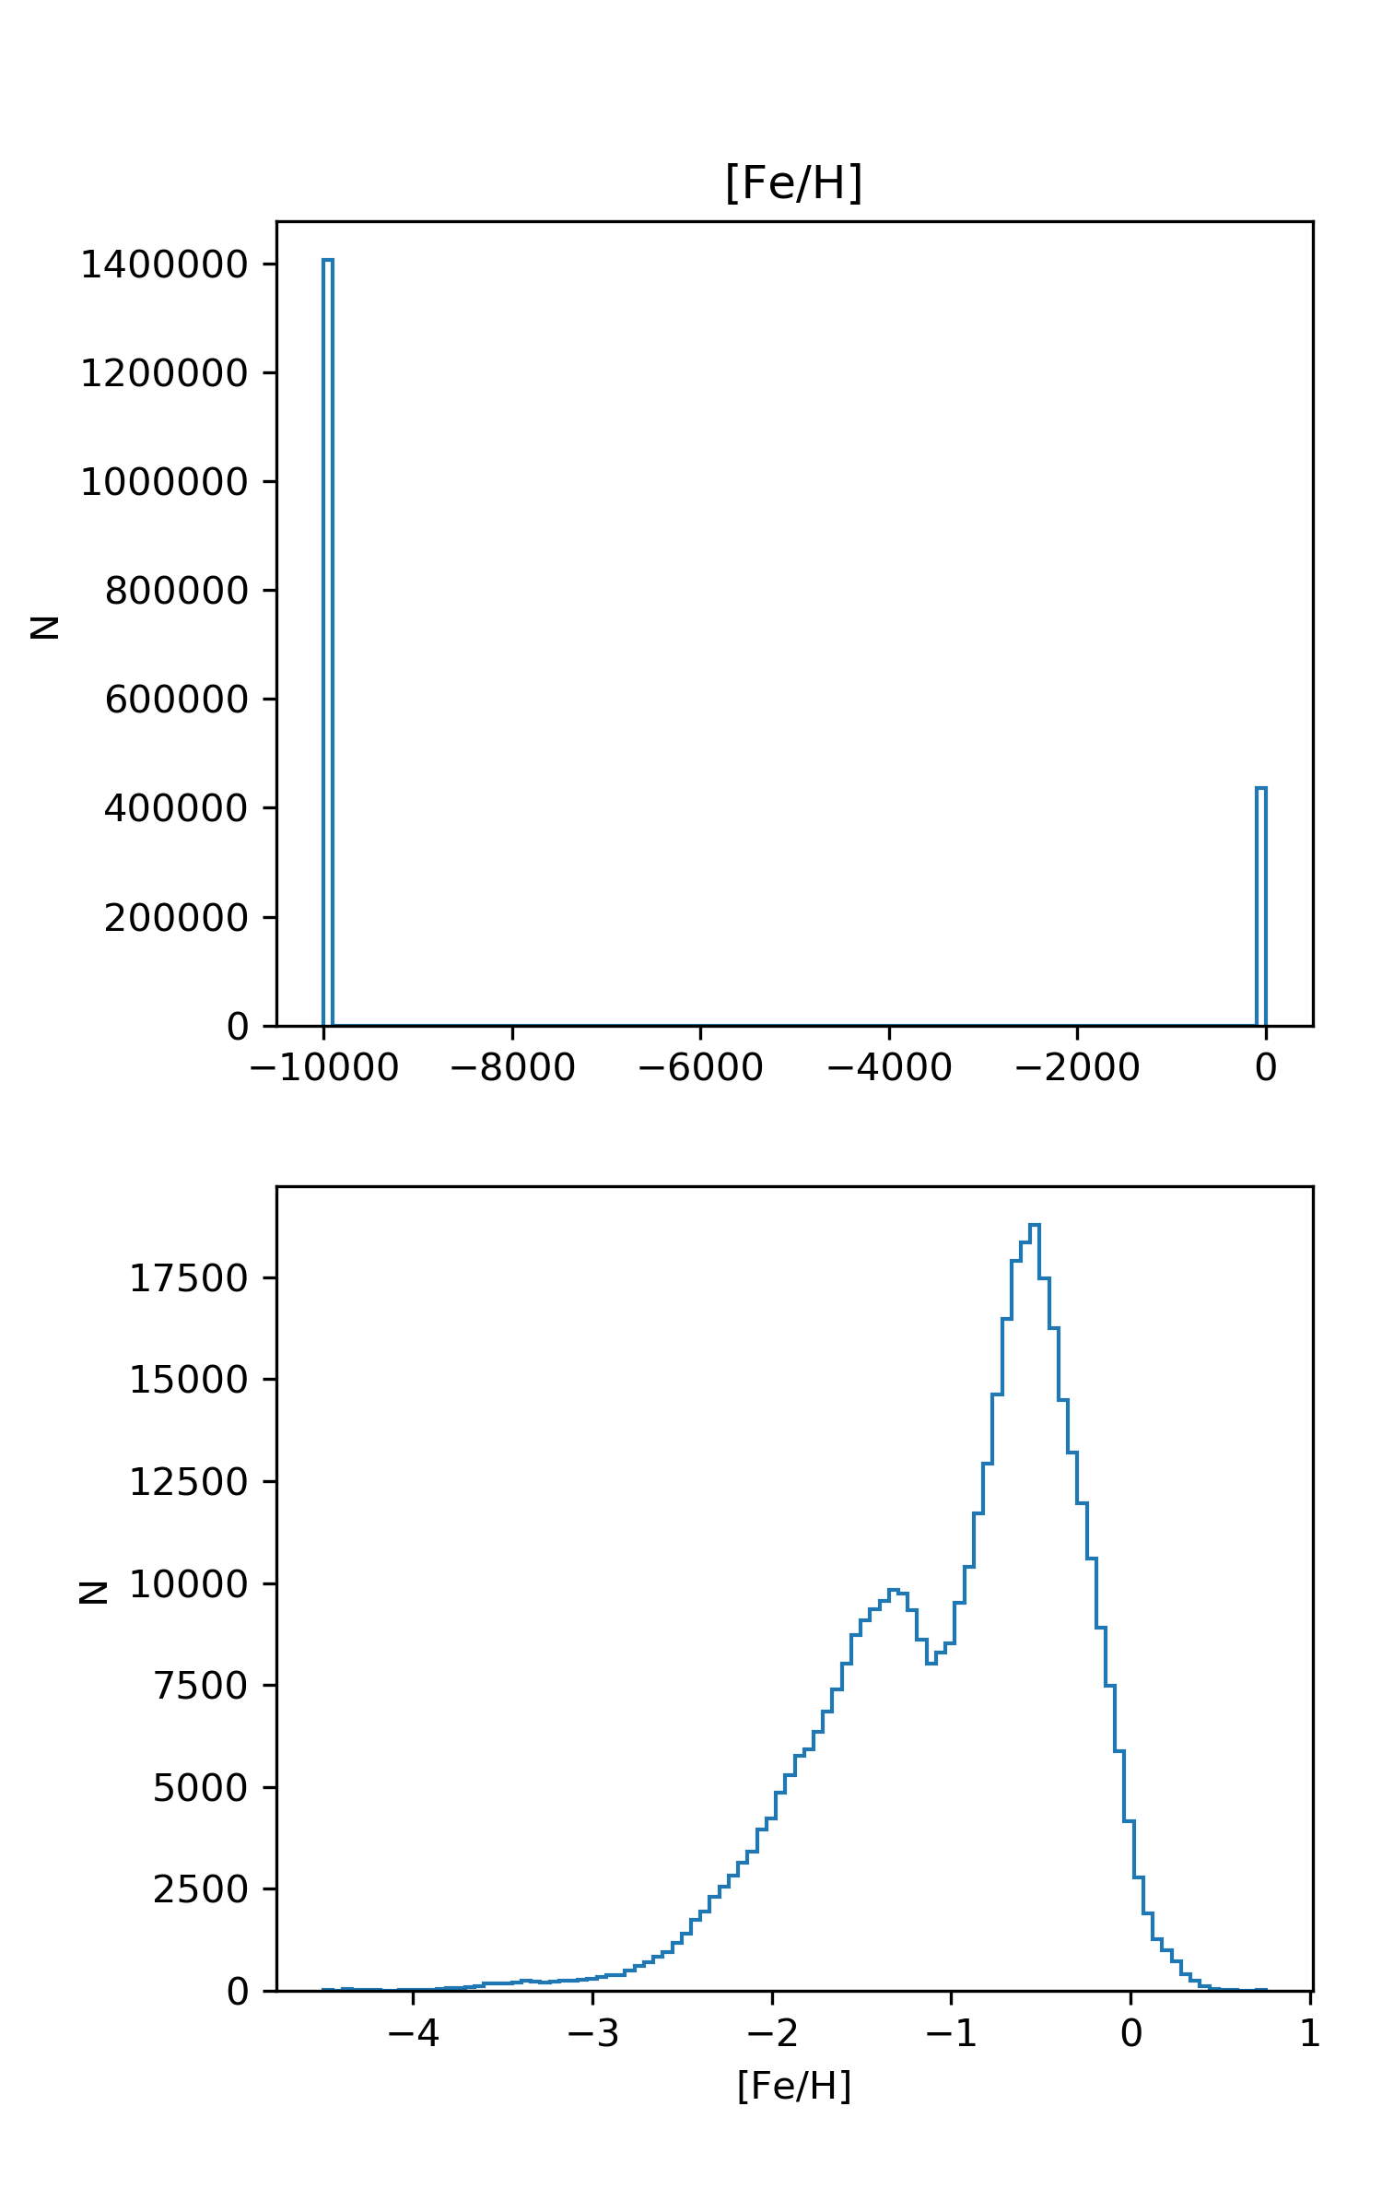
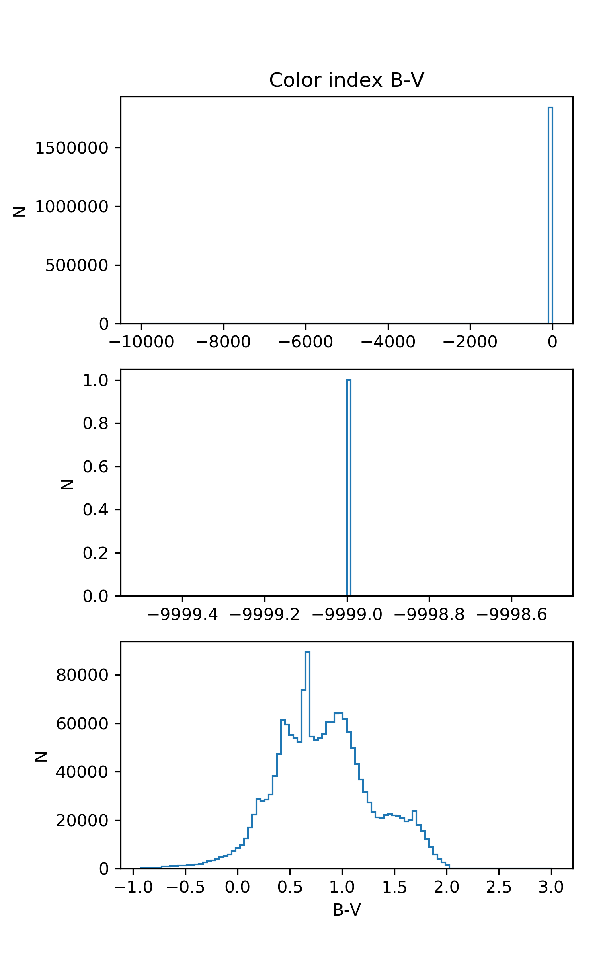
Data
Feature

Slide 9
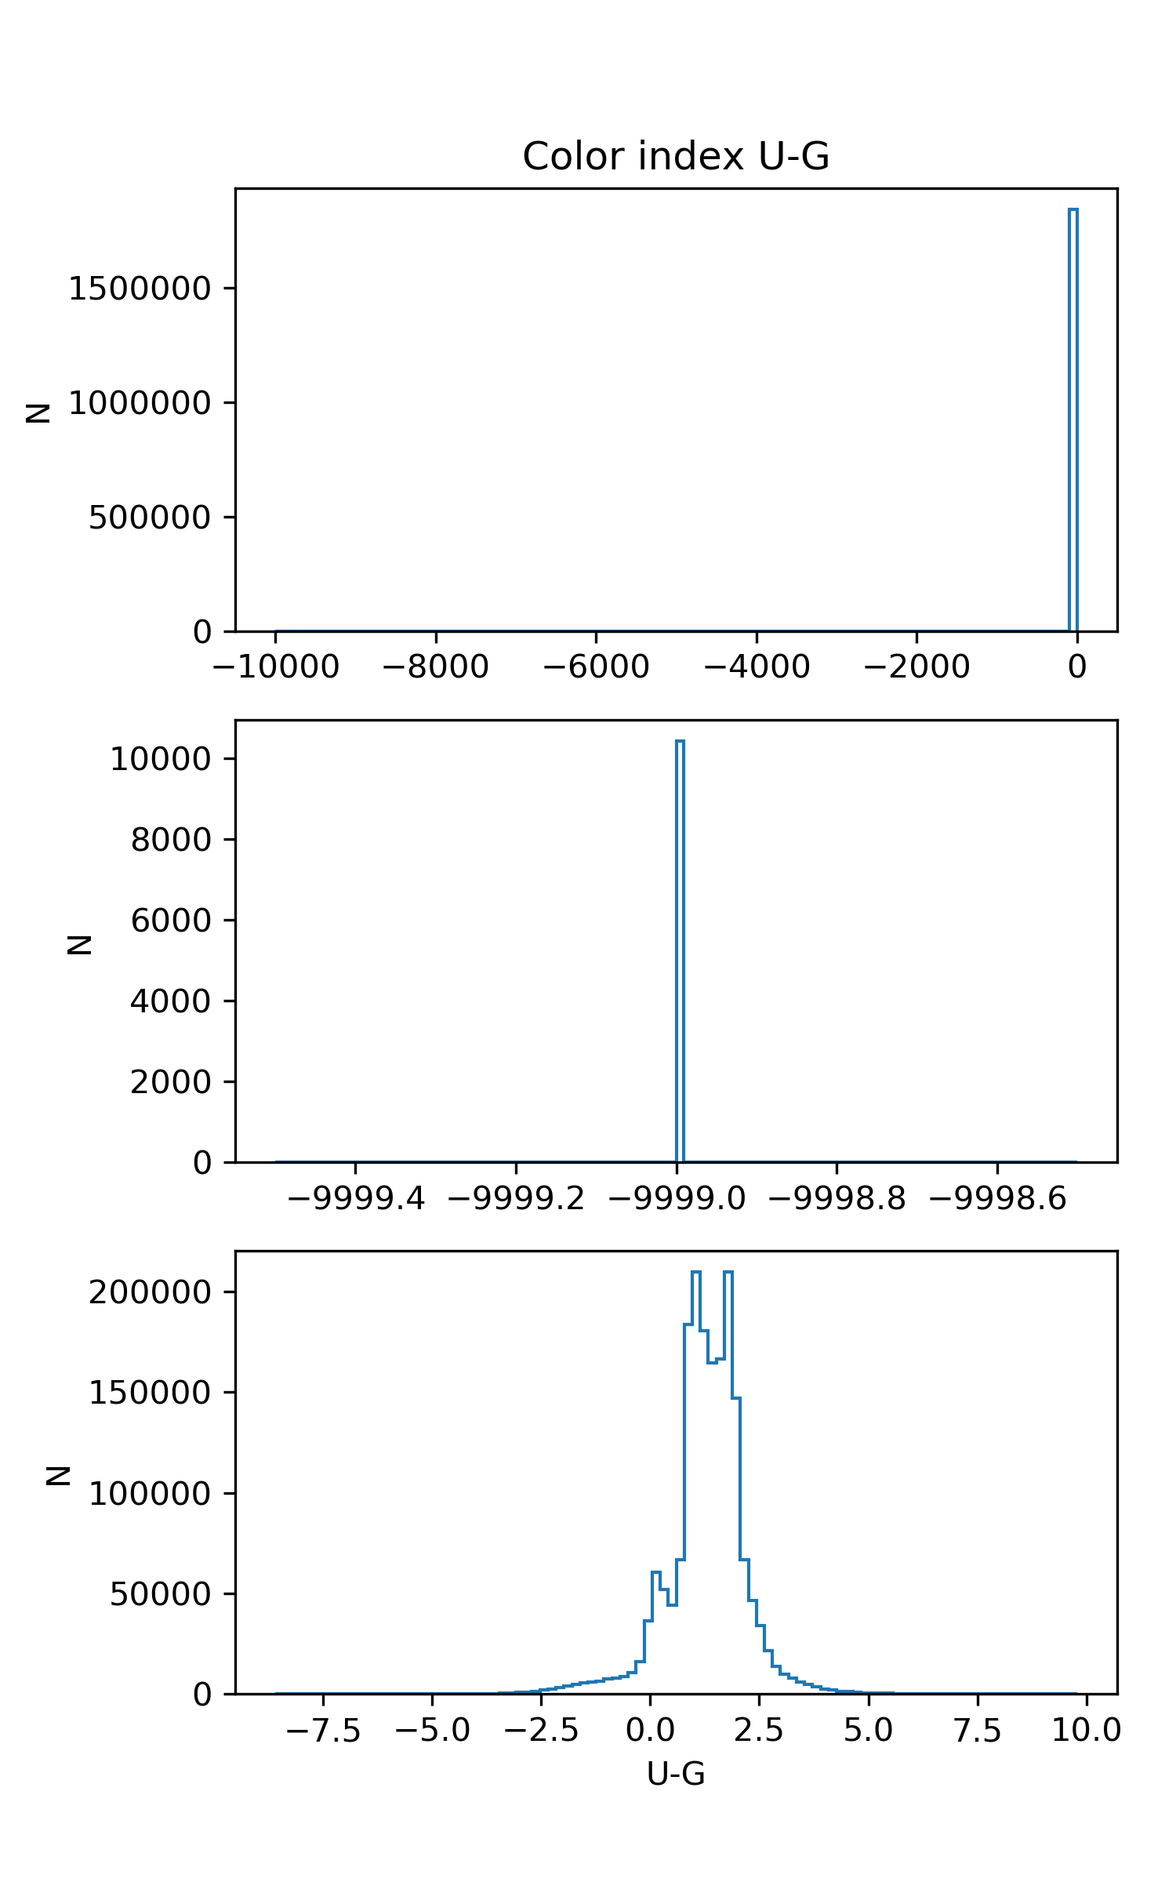
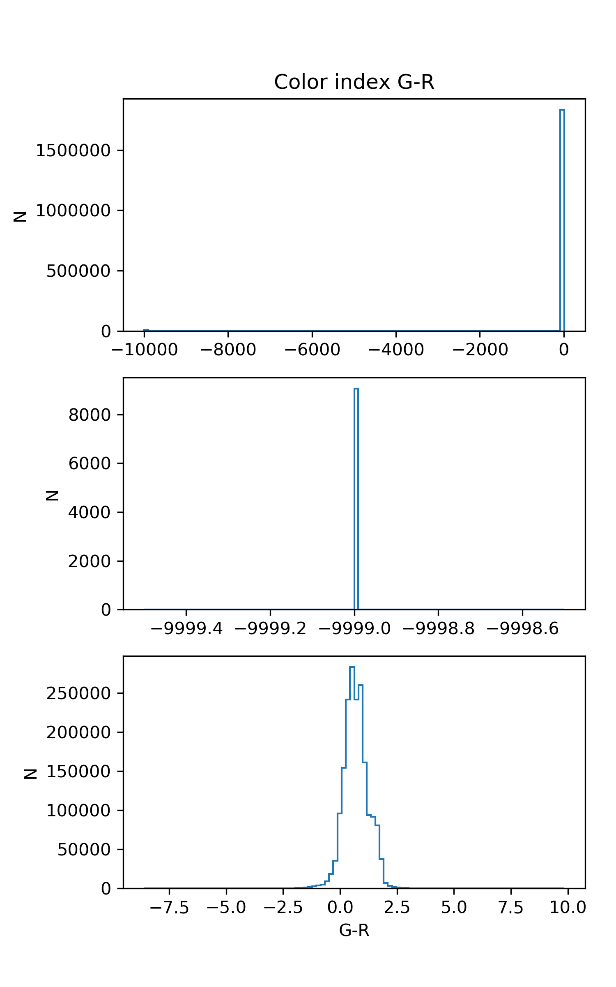
Classification
Data
Feature

Slide 10
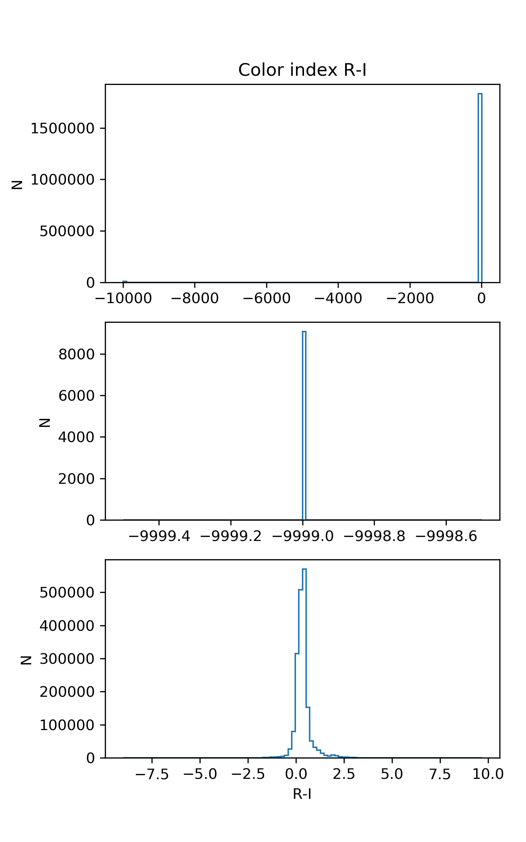
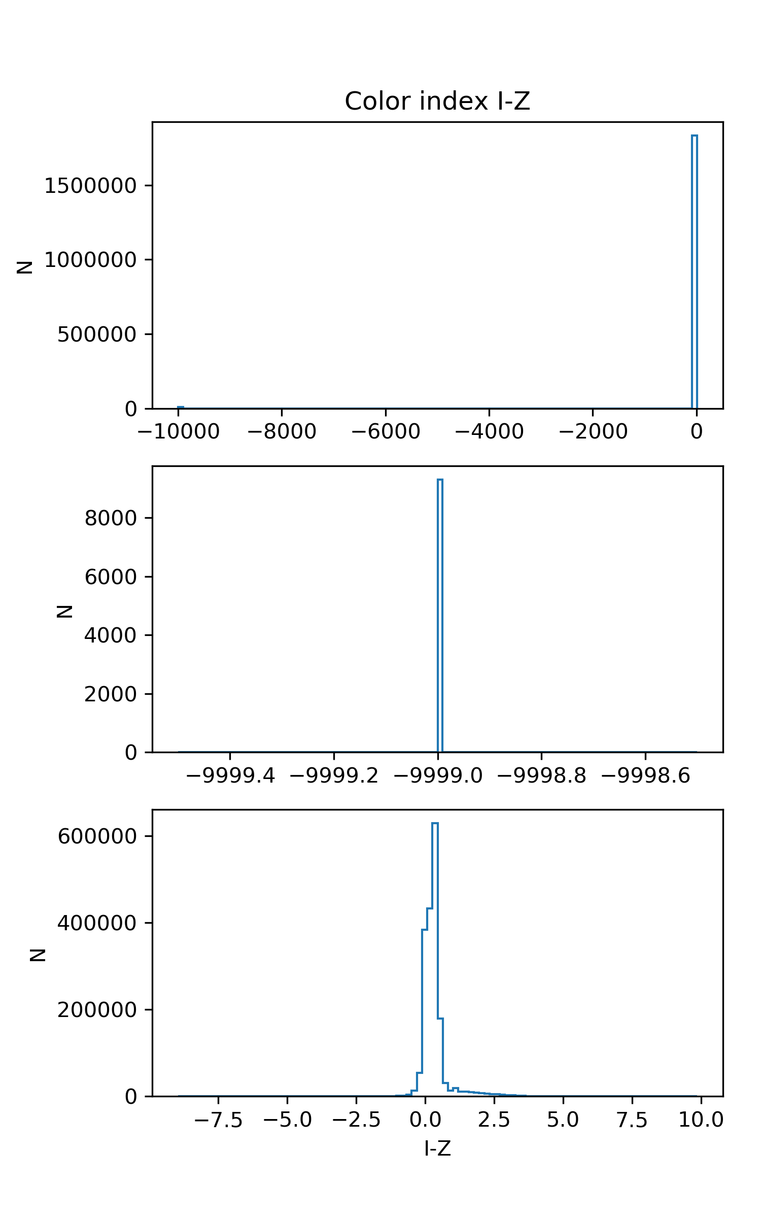
Classification
Data
Feature

Slide 11
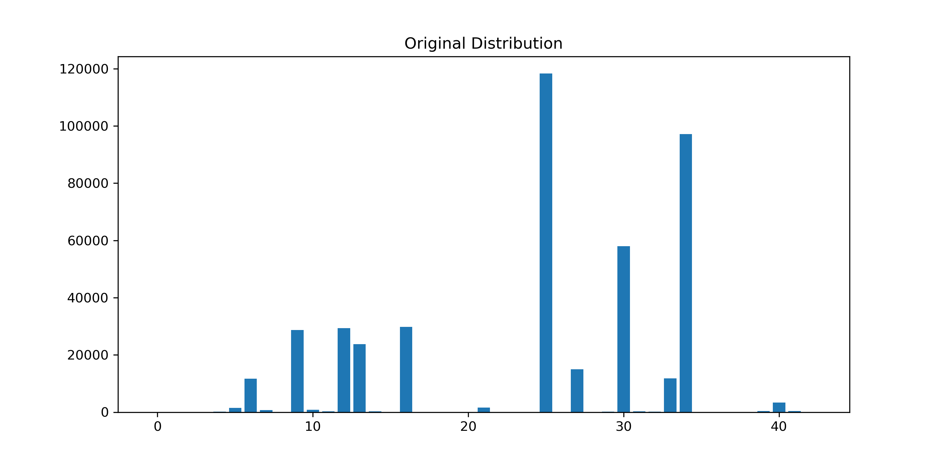
Classification
Classification
Data
Feature
433,876 objects

Slide 12
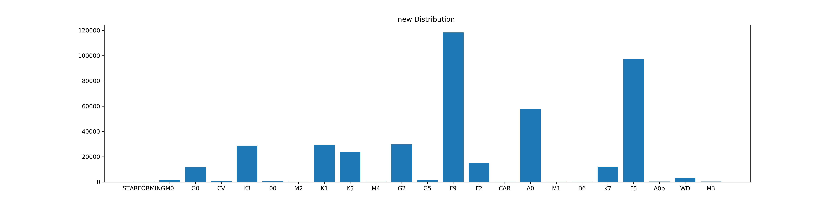
Classification
Classification
Data
Feature
有的class下样本数量太少，不具有代表性 → abandon
Class size > 100
433,561 objects in 23 classes

Slide 13
Classification
Data
Feature
Sampling
Stratified sampling
Training set : Test set = 75% : 25% for each class
Training set : 325,161 samples
Test set : 108,400 samples

Slide 14
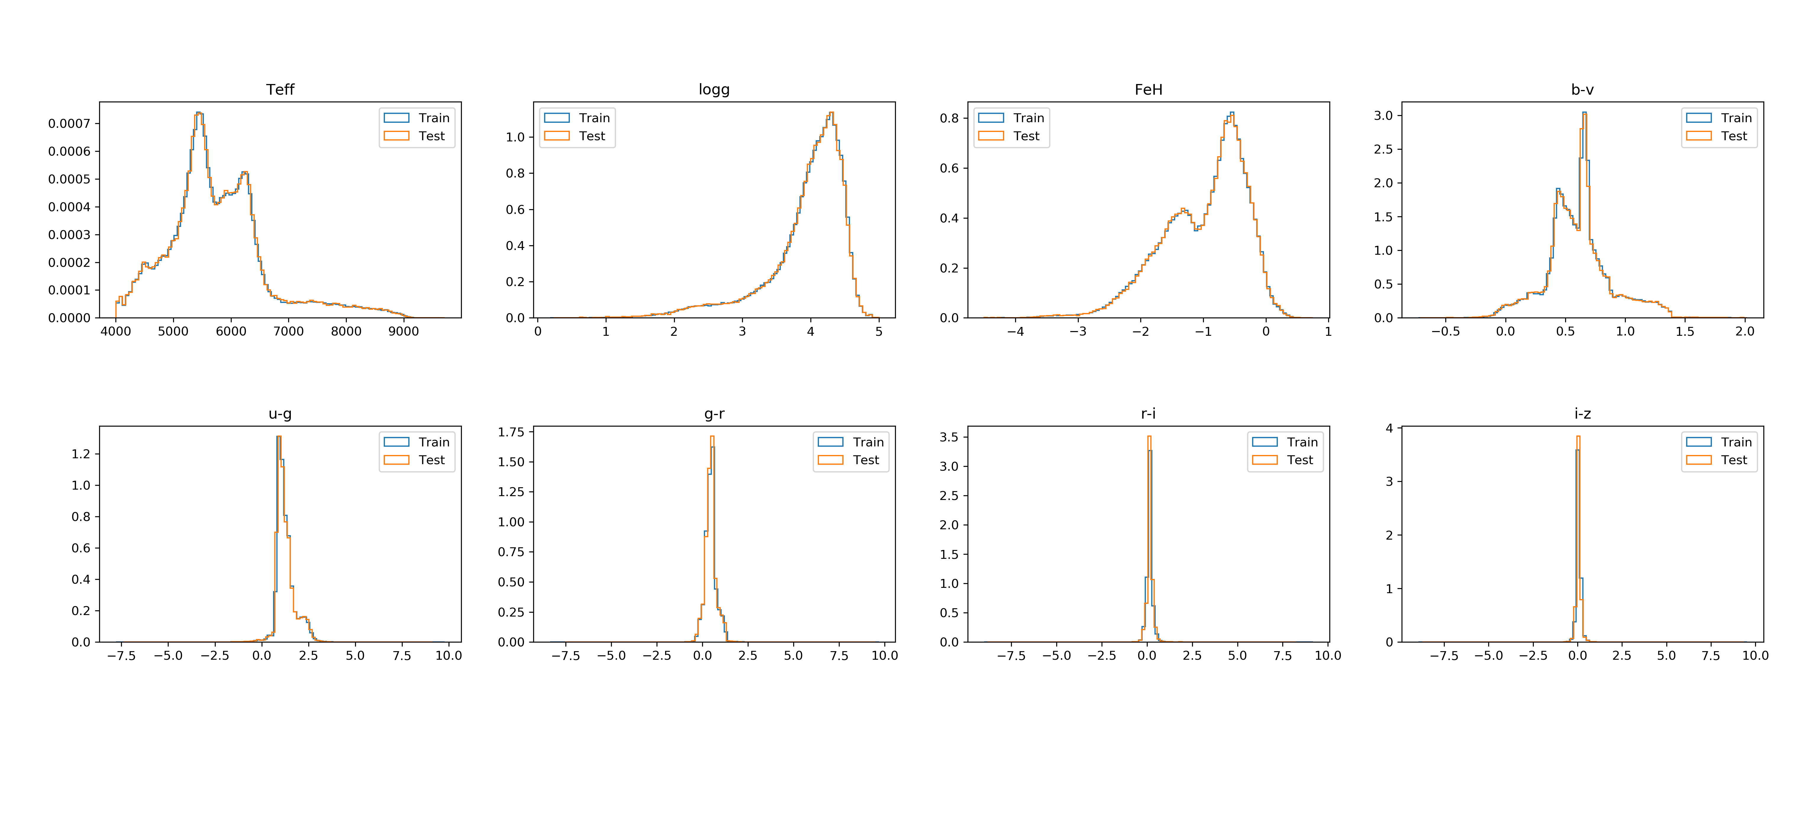
Classification
Data
Feature
Sampling

Slide 15
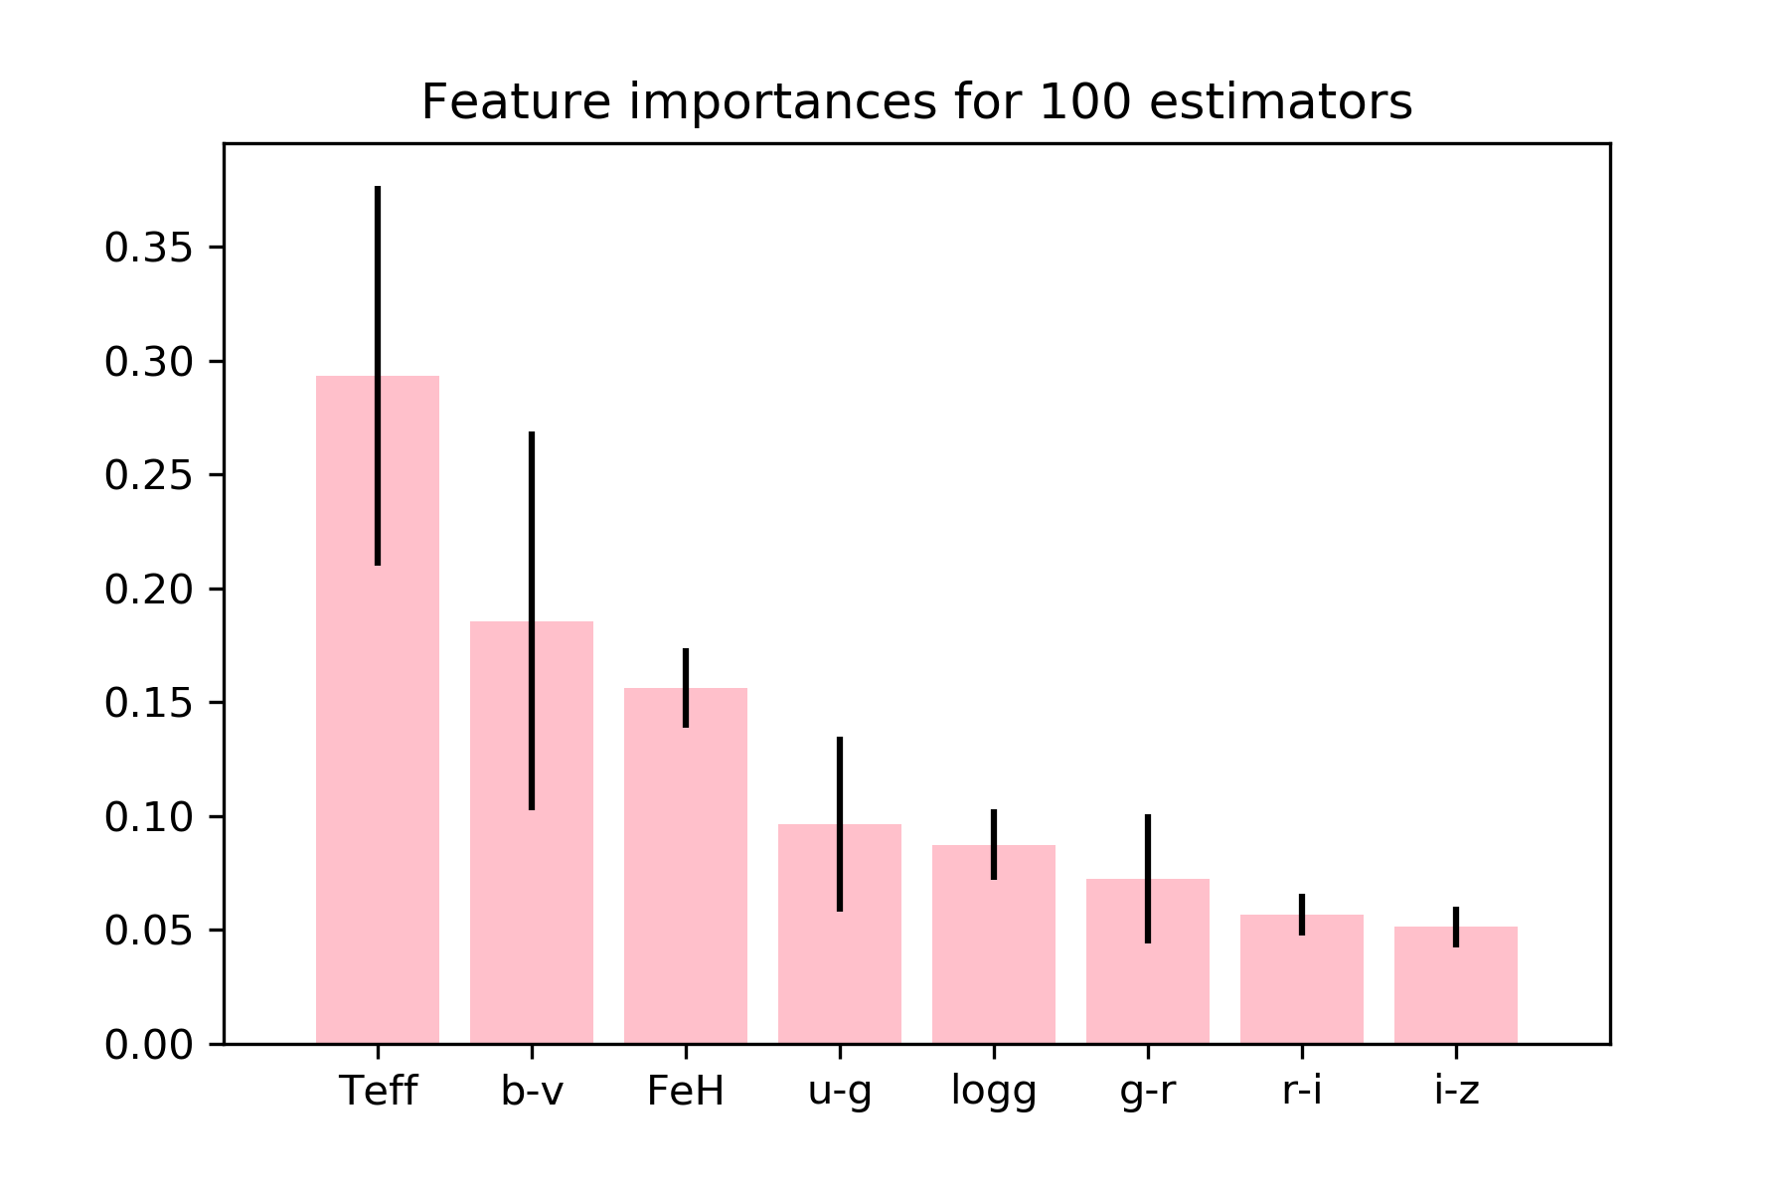

Classification
Data
Feature
Sampling
Classifier
ExtraTree
Random Forest
Use the whole dataset and randomly splits the features

Slide 16
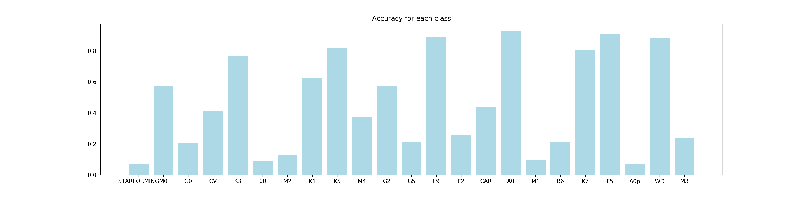
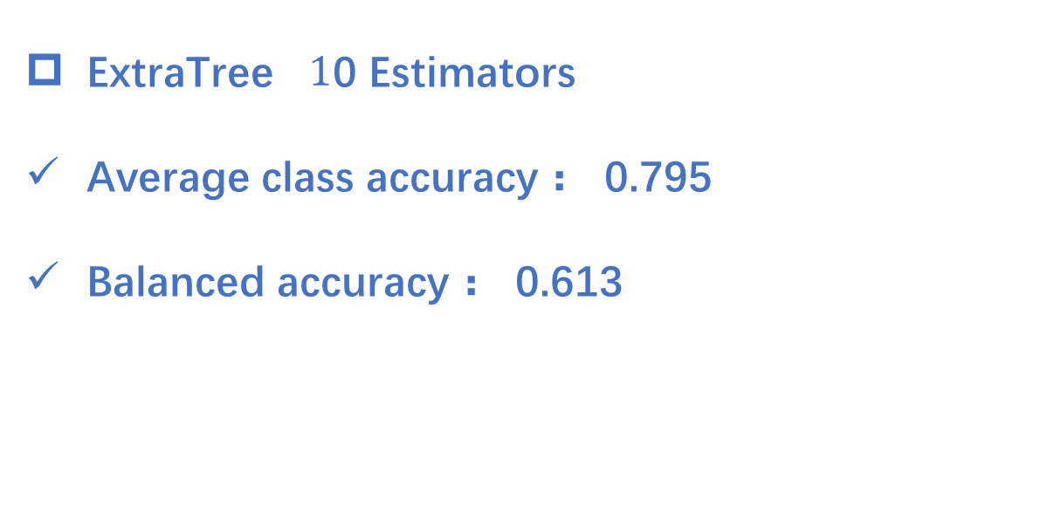
Classification
ExtraTree $1$0 Estimators
Average class accuracy ： 0.795
Balanced accuracy ： 0.613

Slide 17
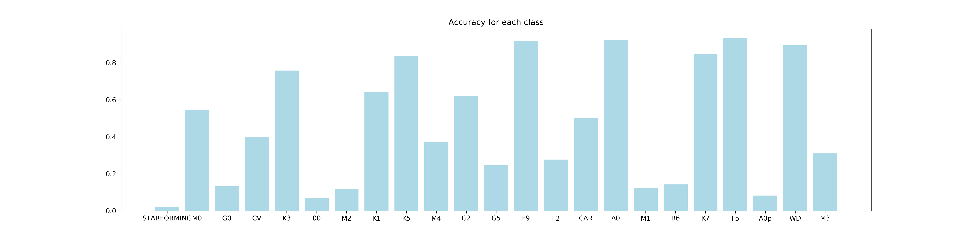
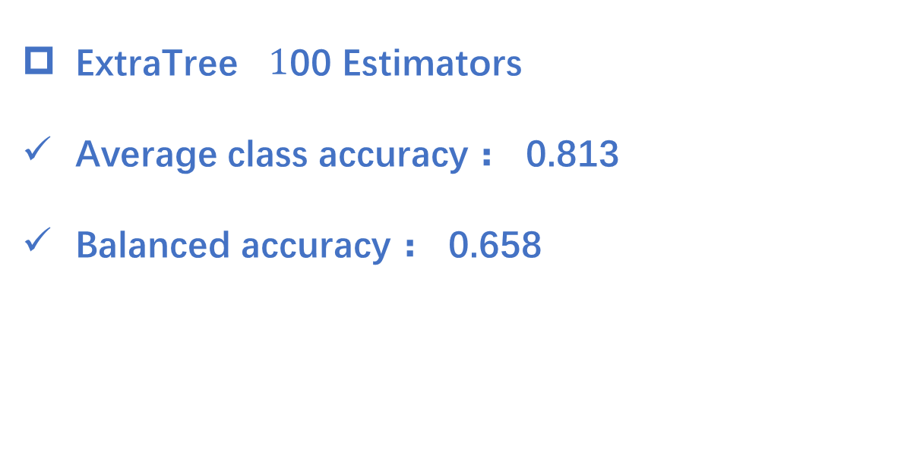
Classification
ExtraTree $1$00 Estimators
Average class accuracy ： 0.813
Balanced accuracy ： 0.658

Slide 18
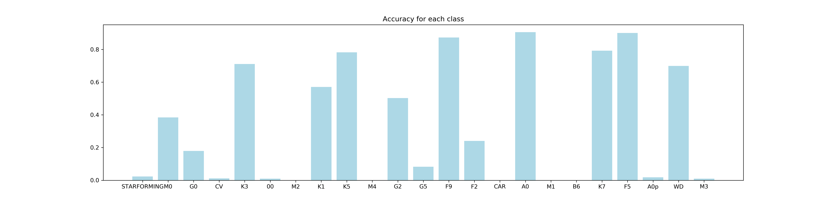
Classification
Data
Feature
Sampling
Classifier
K-neighbors : Distances as weights
5 nearest : average accuracy 0.768, balanced accuracy 0.597
10 nearest
15 nearest

Slide 19
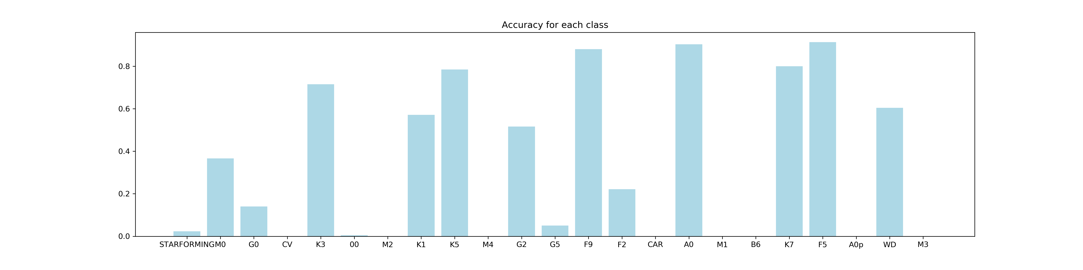
Classification
Data
Feature
Sampling
Classifier
K-neighbors : Distances as weights
5 nearest
10 nearest : average accuracy 0.770, balanced accuracy 0.548
15 nearest

Slide 20
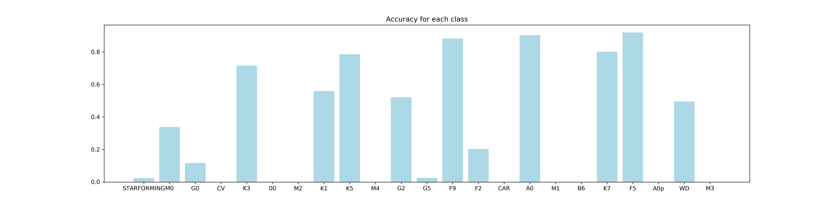
Classification
Data
Feature
Sampling
Classifier
K-neighbors : Distances as weights
5 nearest
10 nearest
15 nearest : average accuracy 0.764, balanced accuracy 0.465

Slide 21
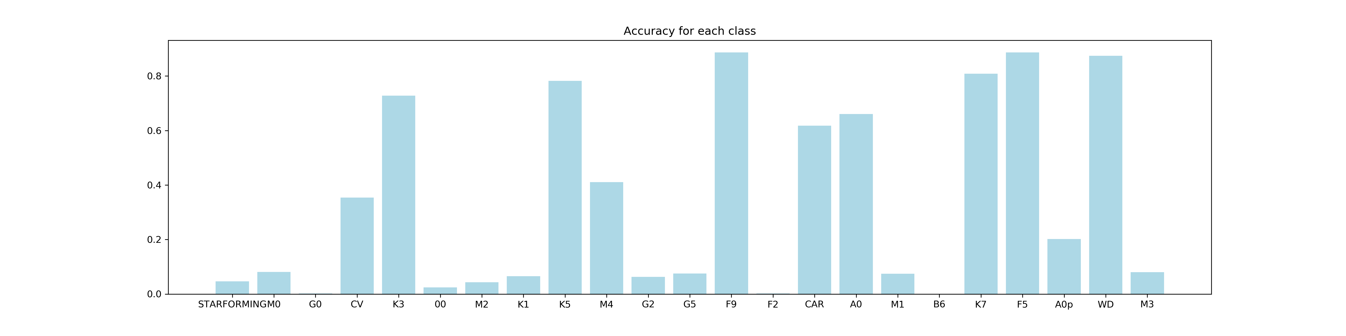
Classification
Data
Feature
Sampling
Classifier
Naïve Bayes (Gaussian)
Prior : Frequency of each class
average accuracy 0.670 , balanced accuracy 0.310

Slide 22
Classification
Data
Feature
Sampling
Classifier
Conclusion
Best : Average Accuracy KNN 10 neighbors
Balanced Accuracy ExtraTree 100 estimators
各个分类下的Accuracy 与class size相关
对于少数派，后续的人工筛选必不可少

Slide 23
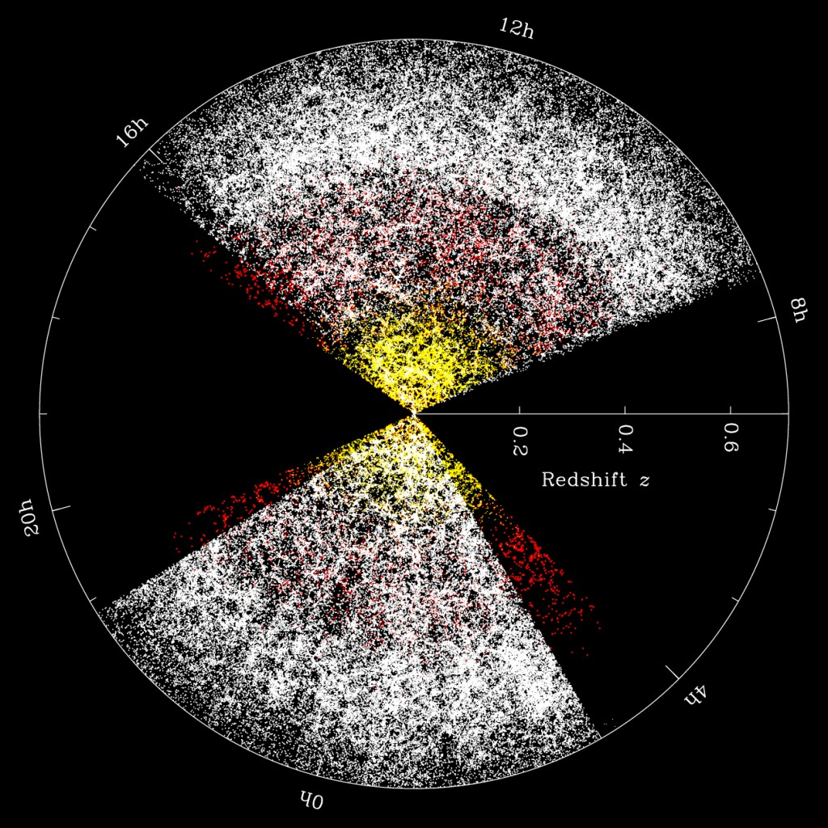
Clustering
宇宙大尺度结构
SDSS : large scale structure
Notes:
大数据/丰富的信息/大面积天区的扫描

Slide 24
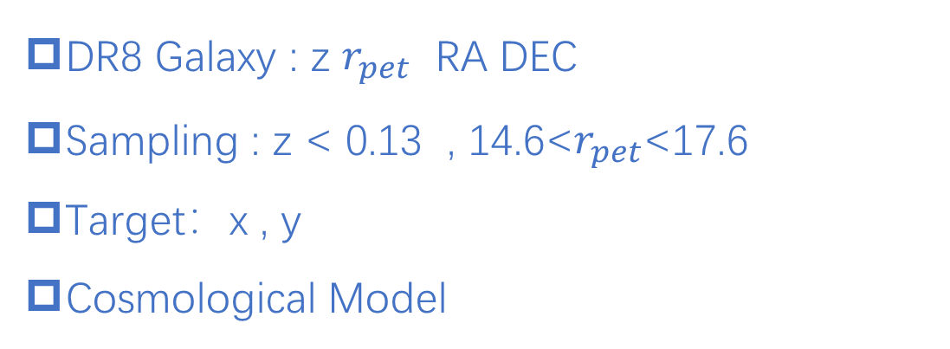
Clustering
Data
DR8 Galaxy : z $r_{pet}$ RA DEC
Sampling : z < 0.13 , 14.6<$r_{pet}$<17.6
Target：x , y
Cosmological Model
Notes:
Classification是clustering的前提 -> 提取galaxy obj

Slide 25
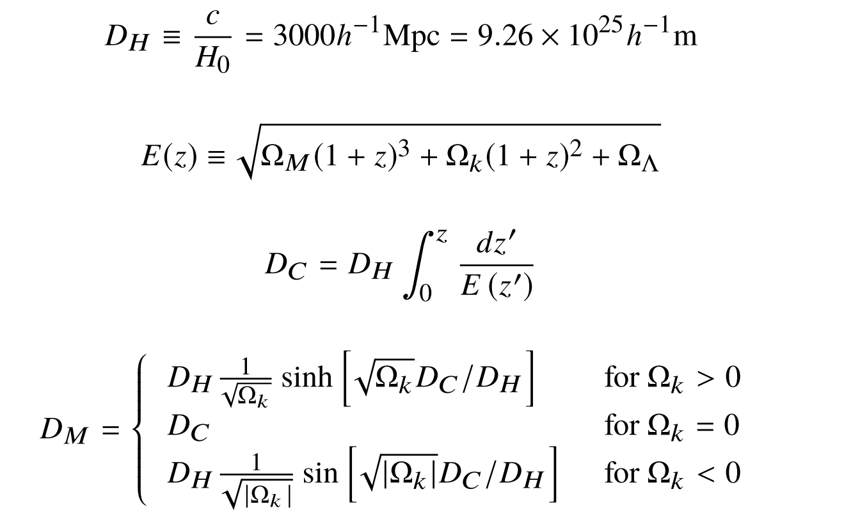
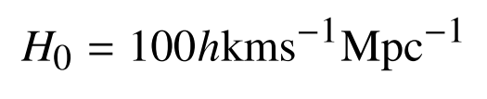
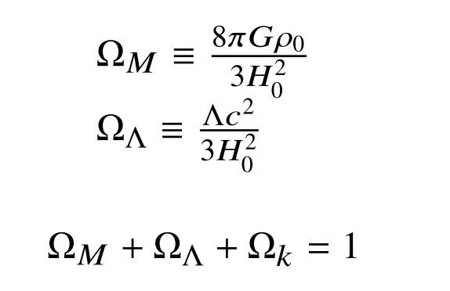
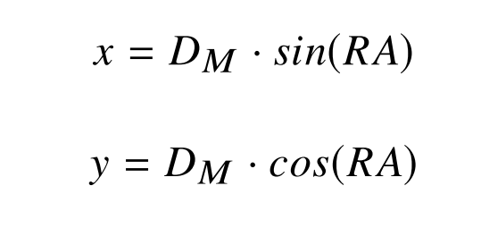
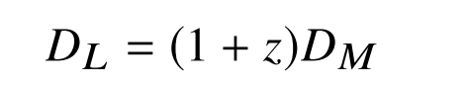
Clustering
Cosmological Model
Data
Preparation

Slide 26
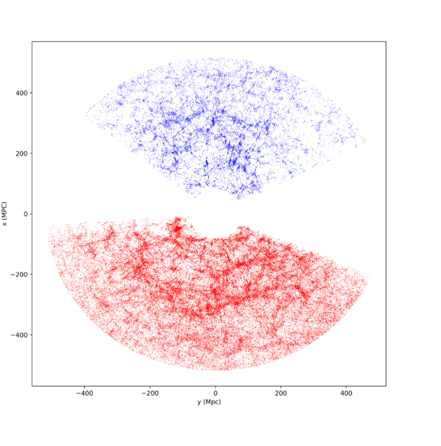
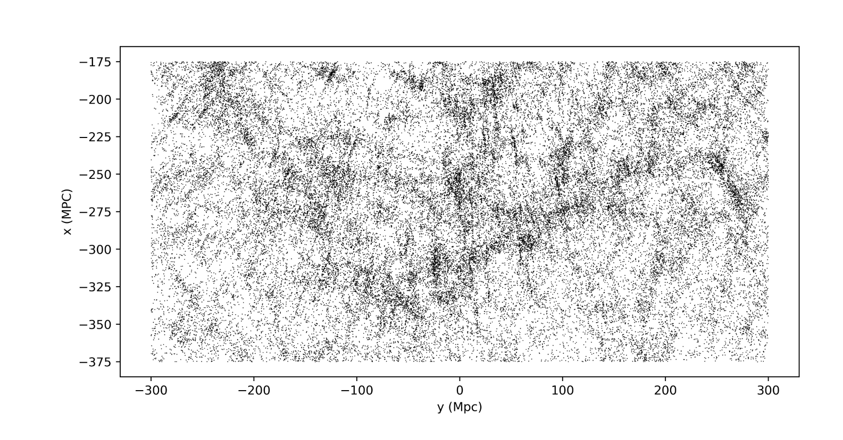
Clustering
Data
Preparation
visualization
SDSS Great Wall
Projection map of the large-scale structure of the universe.

Slide 27
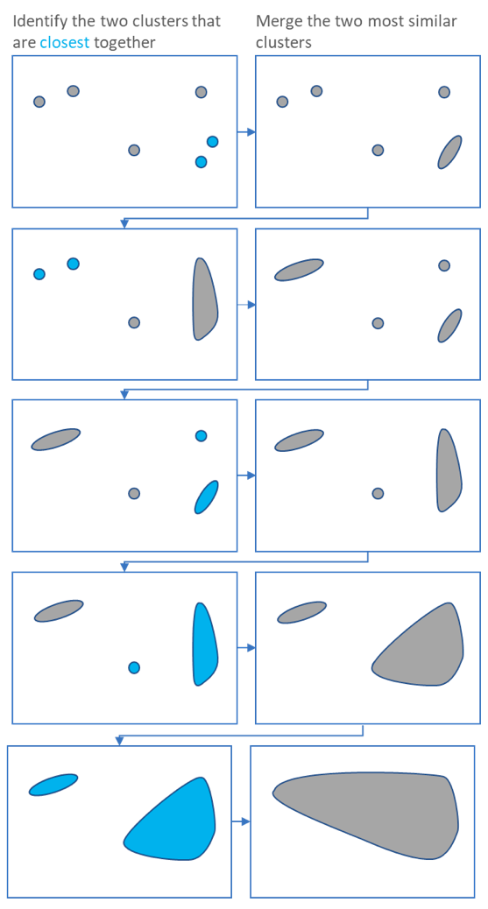
Clustering
Data
Preparation
visualization
Clustering
HCA ( Hierarchical clustering )

Slide 28
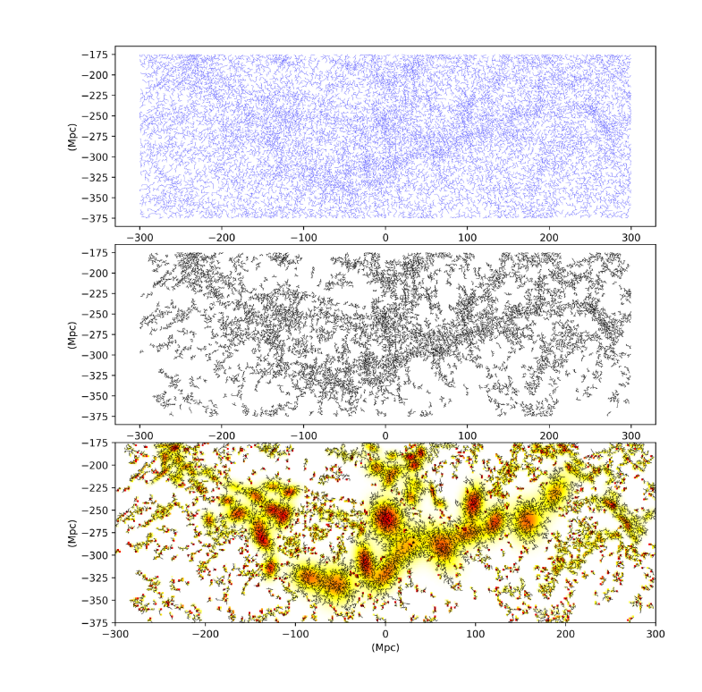
Clustering
Data
Preparation
visualization
Clustering
HCA
n_cluster >= 10
n_neighbor = 10
Density Estimation:
Gaussian Mixtures < 12

Slide 29
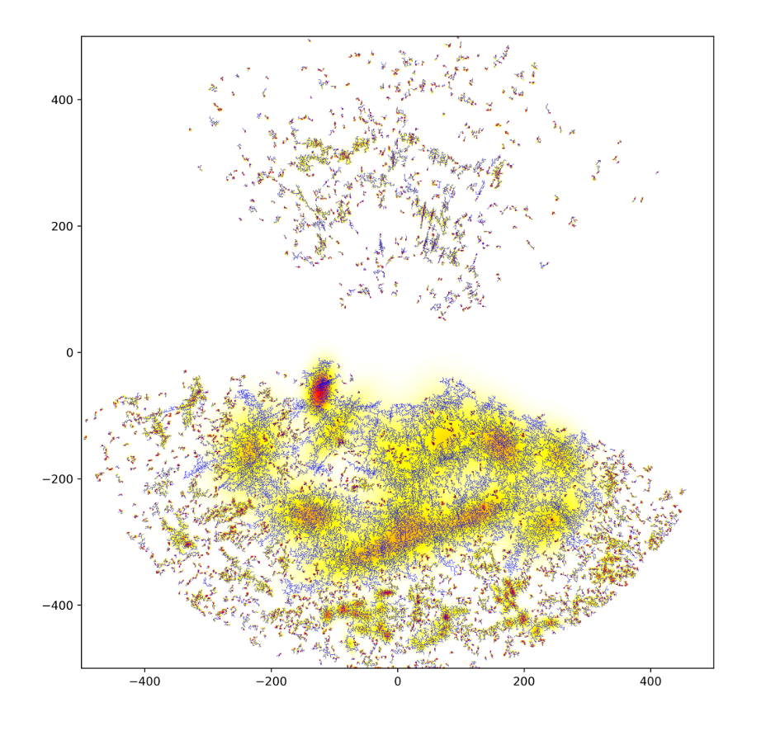
Clustering
Data
Preparation
visualization
Clustering
HCA
n_cluster >= 10
n_neighbor = 10
Density Estimation:
Gaussian Mixtures < 12

Slide 30
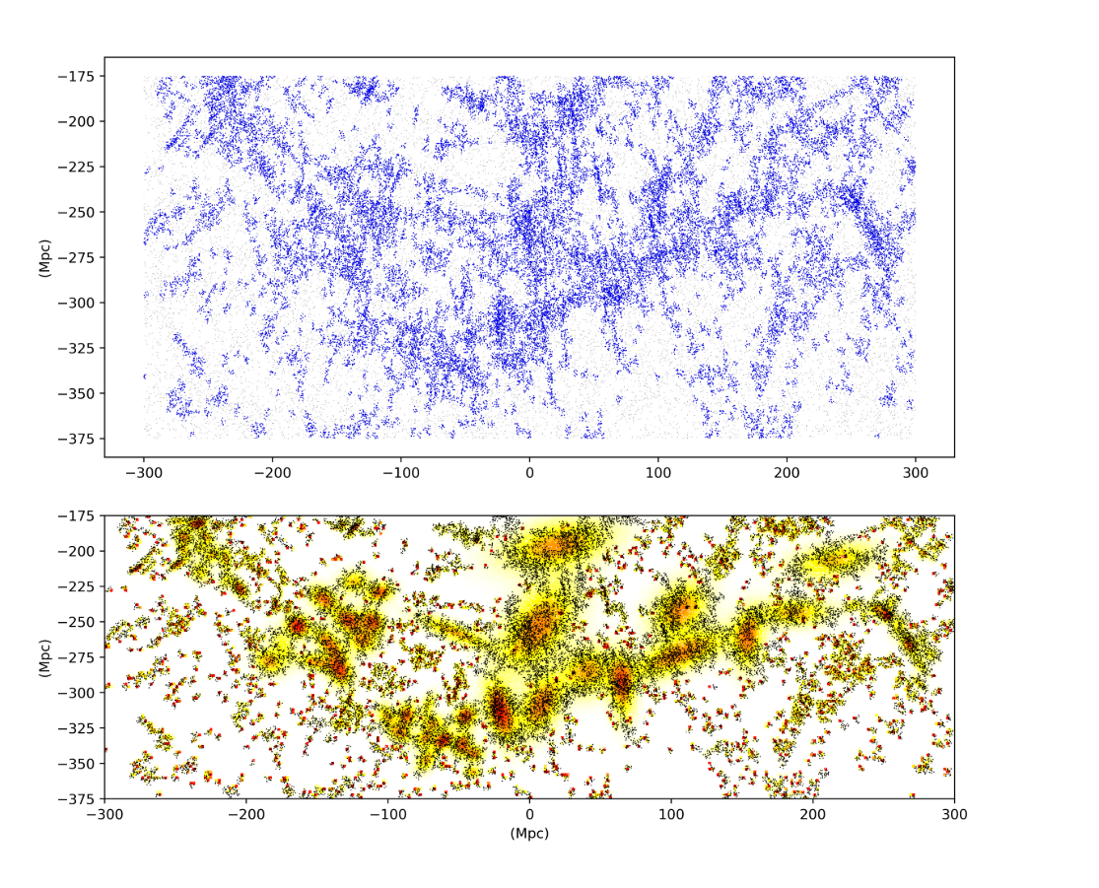
Clustering
Data
Preparation
visualization
Clustering
Density-Based Spatial Clustering of Applications with Noise (DBSCAN)
core samples of high density and expands clusters from them.
High density : refers to a relative large number of neighbors within a selected radius
max_eps =2 (considered as in the neighborhood)
min_samples = 8
Density Estimation:
Gaussian Mixtures < 12

Slide 31
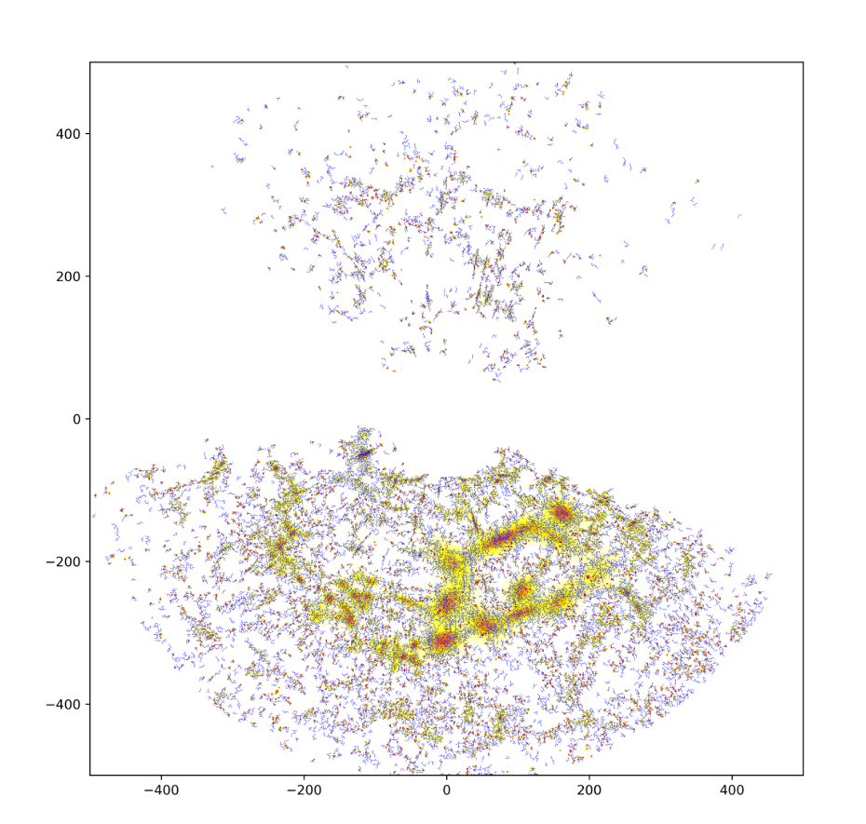
Clustering
Data
Preparation
visualization
Clustering
Density-Based Spatial Clustering of Applications with Noise (DBSCAN)
core samples of high density and expands clusters from them.
High density : refers to a relative large number of neighbors within a selected radius
max_eps =2 (considered as in the neighborhood)
min_samples = 8
Density Estimation:
Gaussian Mixtures < 12

Slide 32
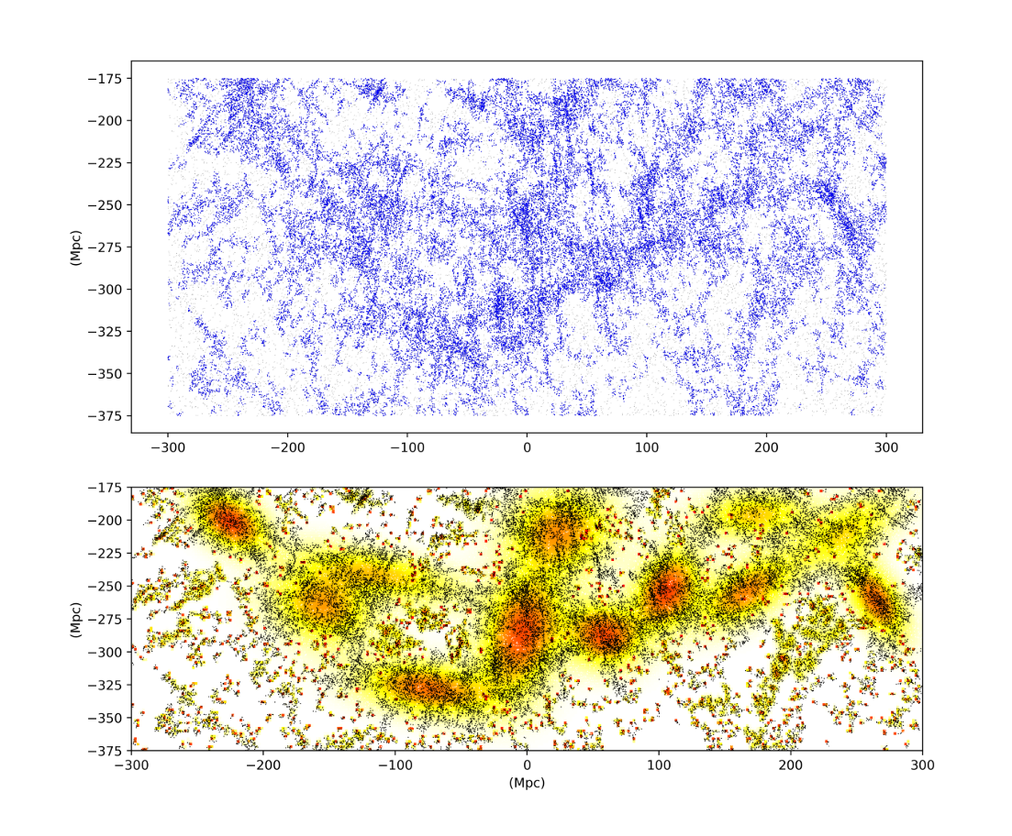
Clustering
Data
Preparation
visualization
Clustering
Ordering Points To Identify the Clustering Structure (OPTICS)
core samples of high density and expands clusters from them.
cluster hierarchy for a variable neighborhood radius
max_eps =2 (considered as in the neighborhood)
min_samples = 8
Density Estimation:
Gaussian Mixtures < 12

Slide 33
Clustering
Data
Preparation
visualization
Clustering
Clustering Result :
我的Machine学傻了
Ordering Points To Identify the Clustering Structure (OPTICS)
core samples of high density and expands clusters from them.
cluster hierarchy for a variable neighborhood radius
max_eps =2 (considered as in the neighborhood)
min_samples = 8
Density Estimation:
Gaussian Mixtures < 12

Slide 34
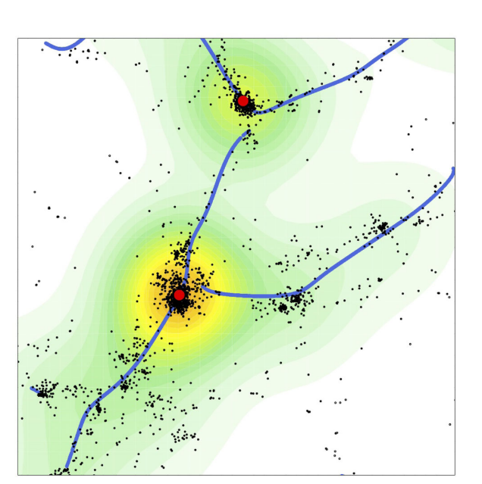
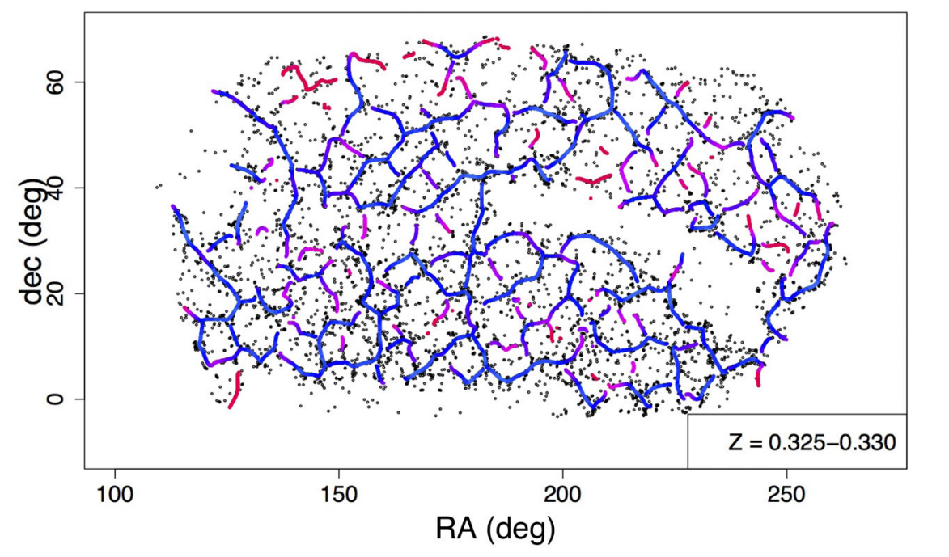
Clustering 能做些什么？
Yen-Chi Chen, McWilliams Center for Cosmology, Carnegie Mellon University
Notes:
Clustering 之后还有很多很有意思的工作可以做

Slide 35
Classification
Data Preparation
Algorithms
Comparation
总结
conclusion
Clustering
Data Preparation
Algorithms
Results

Slide 36
Thanks !
北京大学天文系 林小靖
linxiaojing@pku.edu.cn

